Slide 1
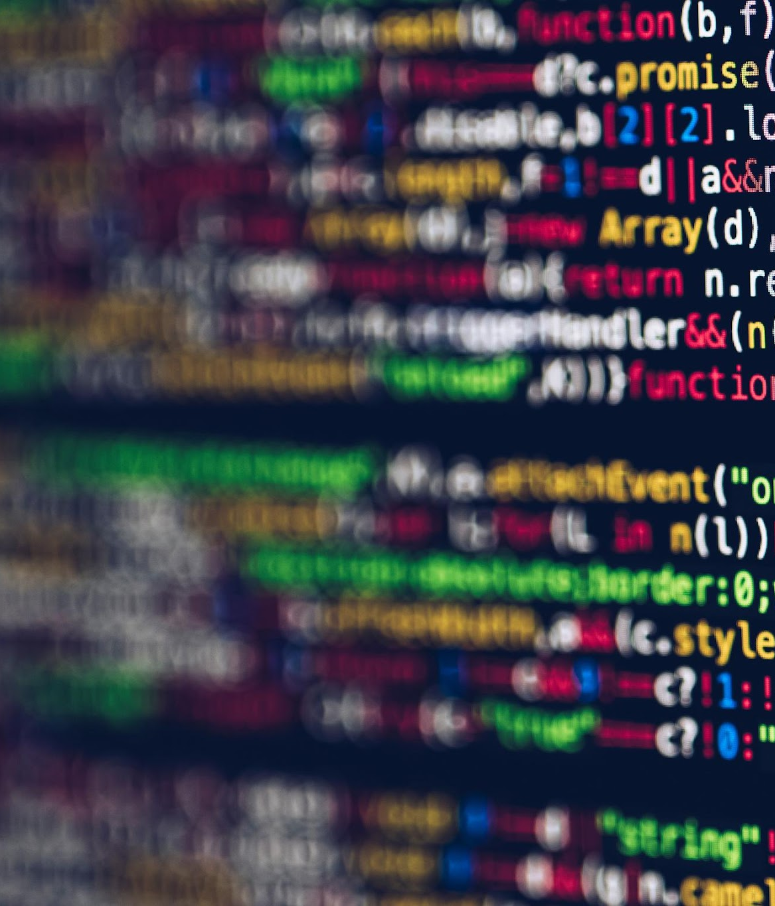
Software
IGCSE CS

Slide 2
Competition
Come up with as many software as possible in 3 minutes

Slide 3
Definition of a Software
A set of instructions written in a programming language that performs one or more tasks to tell the computer what to do.

Slide 4

"Inner look" on software - 2048

Slide 5
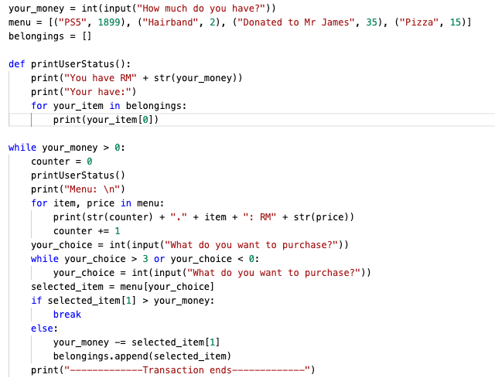
"Inner look" on software - basic shop
Code that will be run when the player decides to buy an item
- JUST ONE ACTION

Slide 6
Classification of Software
Application Software
System Software

Slide 7
System Software
Definition
A variety of programs that a computer needs to function.

Slide 8
System Software
Definition
Example
A variety of programs that a computer needs to function.
  Basic Input Output System (BIOS) - installed in ROM. Enables all of the attached components to initialise. Known as firmware.

Slide 9
System Software
Definition
Example
A variety of programs that a computer needs to function.
  Basic Input Output System (BIOS) - installed in ROM. Enables all of the attached components to initialise. Known as firmware.
  Operating System - MAC, Windows, Android, iOS.

Slide 10
System Software
Definition
Example
A variety of programs that a computer needs to function.
  Basic Input Output System (BIOS) - installed in ROM. Enables all of the attached components to initialise. Known as firmware.
  Operating System - MAC, Windows, Android, iOS.
  Device Driver (Part of the OS or Installed manually) - A software that enables hardwares to communicate with the operating system (Plug and play).

Slide 11
System Software
Definition
Example
A variety of programs that a computer needs to function.
  Basic Input Output System (BIOS) - installed in ROM. Enables all of the attached components to initialise. Known as firmware.
  Operating System - MAC, Windows, Android, iOS.
  Device Driver (Part of the OS or Installed manually) - A software that enables hardwares to communicate with the operating system (Plug and play).
  Compilers - Translate high-level programming language into machine code.

Slide 12
System Software
Definition
Example
A variety of programs that a computer needs to function.
  Basic Input Output System (BIOS) - installed in ROM. Enables all of the attached components to initialise. Known as firmware.
  Operating System - MAC, Windows, Android, iOS.
  Device Driver (Part of the OS or Installed manually) - A software that enables hardwares to communicate with the operating system (Plug and play).
  Compilers - Translate high-level programming language into machine code.
  Utilities Software - Built into the operating system to carry out a specific task.

Slide 13
System Software
Definition
Example
A variety of programs that a computer needs to function.
  Basic Input Output System (BIOS) - installed in ROM. Enables all of the attached components to initialise. Known as firmware.
  Operating System - MAC, Windows, Android, iOS.
  Device Driver (Part of the OS or Installed manually) - A software that enables hardwares to communicate with the operating system (Plug and play).
  Compilers - Translate high-level programming language into machine code.
  Utilities Software - Built into the operating system to carry out a specific task.
Function
  Allows software and hardware to run without problems.
  Provides a human computer interface.
  Control the allocation and usage of hardware resources.

Slide 14



Examples of utilities software (1)
  Offered by the operating system
  Must be constantly updated
  How they work
    The software is constantly running in the background
    Check software of files before they are run or loaded
    Compare a possible virus against a database of known viruses
    Any possible files or programs which are infected are put into quarantine
Virus Checker - Anti Virus Software

Slide 15
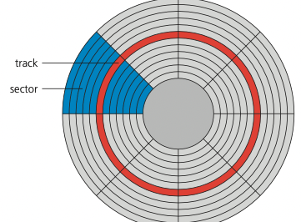
Examples of utilities software (2)
Defragmentation Software - When HDD becomes full, blocks used for files will be scattered all over the disk surface. Data accessing will be faster if files could be stored in contiguous sectors to reduce HDD head movements.
data
data
data
data
data
data

Slide 16



Examples of utilities software (3)
  Software that communicate with the OS and translate data into a format understood by a hardware device (middle man)
  Without device drivers, a hardware device would be unable to work with a computer
  As soon as a device is plugged into a USB port, the OS looks for appropriate device driver
Device Driver

Slide 17

Examples of utilities software (4)
  It is a good practice to use the operating system back-up utility
  Allow a schedule for backing up files to be made
  Total security
    Working version stored in SSD/HDD
    Locally backup stored in removable SSD/HDD
    Cloud Storage
  OS
    Windows - File History
    MacOS - TimeMachine
Backup Software

Slide 18
Application Software
Definition
Software that a user needs to make use of the computer system

Slide 19
Application Software
Definition
Examples
Software that a user needs to make use of the computer system
  Word Processor
  Spreadsheet
  Database
  Video Editing Software
  Apps
    Music and video streaming
    GPS
    Camera facility

Slide 20
Application Software
Definition
Examples
Software that a user needs to make use of the computer system
  Word Processor
  Spreadsheet
  Database
  Video Editing Software
  Apps
    Music and video streaming
    GPS
    Camera facility
Features
  Used to perform various applications (apps) on a computer
  Allows a user to perform specific tasks using the computer’s resources

Slide 21
Classification of Software
System Software - The Manager
Responsible for managing the hardware and other software in a computer
Eg. BIOS, OS, Device Driver, Utilities

Slide 22
Classification of Software
System Software - The Manager
Application Software -
The Independent
Allows the user to perform different tasks using the computer
Responsible for managing the hardware and other software in a computer
Eg. BIOS, OS, Device Driver, Utilities
Eg. Word Document, Spreadsheet,
Video Editing Software, Games

